Slide 1
Membership Benefits
Margaret Head Sims
Health & Insurance Committee Chair

Slide 2
WebMD
WebMD is being replaced. Be sure to use your rewards by December 31, 2023

Slide 3
Legaline
Rebecca Park
1-800-232-1090
8:00AM-12:00 and 1:00-4:00 PM

Slide 4
Kimbler Memorial Scholarship
”Give back to the future”
This Photo by Unknown Author is licensed under CC BY

Slide 5
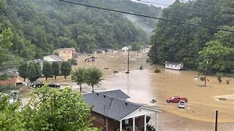
Bourgard Foundation
”Retirees in need”

