Slide 1
Membership
Debby Murrell & Betty Hester
Membership Committee Co-Chair

Slide 2
Membership Chair Central KY East
Karen Gilbert
766 Boone Creek Rd
Stanton, KY 40380
859-227-6537
karenhcgilbert@gmail.com

Slide 3
Membership Chair Central KY West
MARIANNE LEET
4390 BLUE LICK PIKE
MOUNT OLIVET, KY 41064
LEETMARIANNE@GMAIL.COM

Slide 4
Membership Chair Northern District
Janet Sogar
36 Amherst Ct
Florence, KY 41042
513-476-7434
janetsogar@gmail.com

Slide 5
Membership Chair 5th District
Becky Woods
108 Delaware Circle
Carrollton KY 41008
502-732-9020
bwoods22222@gmail.com

Slide 6
Membership Chair 1st District
Anita Thomas
842 We Like It Lane
Gracey KY 4222
270-885-6252/270-348-4974
thomasanita@bellsouth.net

Slide 7
Membership Chair 2nd District
PEGGY COOMES
225 FREDERICK ST
MADISONVILLE, KY 42431
270-832-8224
PEGGYACOOMES@GMAIL.COM

Slide 8
Membership Chair 3rd District Main Cont.
Sherry Radford
146 Spring Lane
Burkesville, KY 42717
270-864-9590/270-459-0858
sherryradford94@gmail.com

Slide 9
Membership Chair 3rd District Warren Co.
SHERRY RADFORD
146 SPRING LN
BURKESVILLE, KY 42717
270-864-9590
SHERRYRADFORD94@GMAIL.COM

Slide 10
Membership Chair 4th District
Patsy Young
418 Ridgecrest Rd
Elizabethtown KY 42701
270-765-7964/270-763-275
pmyoung1@windstream.net

Slide 11
Membership Chair Middle Cumberland
Shirley Ryan
2060 Grider Hill Dock Rd
Albany KY 42602
606-278-4795
shirleyryan@windstream.net

Slide 12
Membership Chair Upper Cumberland
Debra Payne
8702 South Ky
Barbourville, Ky 40965
H 606-546-8394 IC 606-627-0357
blumoonky40906@yahoo.com

Slide 13
Membership Chair Upper KY River
Mike Caudill
392 Civil War Gap
Carcassonne KY 41804
606-633-9691/606-454-4052
m48ortal.@gmail.com

Slide 14
Membership Chair Big Sandy
Wanda Mollett
7672 KY RT 40 E
Williamsport KY 41271
606-789-5041/606-793-4618
bobandwanda@bigsandybb.com

Slide 15
Membership Chair Eastern
Lana Combs
200 Dusty Rd
Morehead KY 40351
606-784-6161/606-356-0223
lanacombs@gmail.com

Slide 16
2023-24 Membership Goal
31,668

Slide 17
New Membership Handbook
Available at krta.org

Slide 18
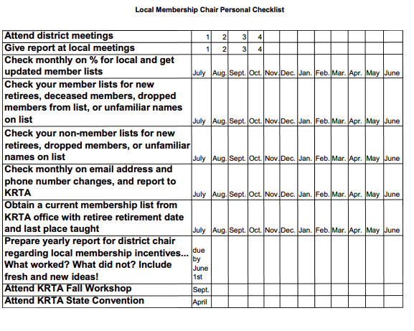
What to do when.......

